Slide 1



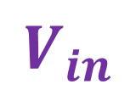

$$C$$
$$V_{in}$$
$$D$$
$$R_{L}$$
$$V_{O}$$

Slide 2

$$C$$
$$V_{in}$$
$$D$$
$$R_{L}$$
$$V_{O}$$

Slide 3

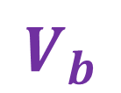
$$C$$
$$V_{in}$$
$$D$$
$$R_{L}$$
$$V_{O}$$
$$V_{b}$$

Slide 4
$$C$$
$$V_{in}$$
$$D$$
$$R_{L}$$
$$V_{O}$$
$$V_{b}$$

Slide 5
$$C$$
$$V_{in}$$
$$D$$
$$R_{L}$$
$$V_{O}$$
$$V_{b}$$

Slide 6
$$C$$
$$V_{in}$$
$$D$$
$$R_{L}$$
$$V_{O}$$
$$V_{b}$$

